Slide 1
Federated learnIng & CybersecurIty
PRESENTATION
PRESENTED BY:
Theresa Maria Ghantous

Slide 2
FL course
What is a gradient?
A gradient tells the model how to change its model parameters to reduce the loss.
b) What is the local loss function?
The loss computed on a single client’s private dataset. Clients try to minimize this loss during local training.

Slide 3
FL attacks
Model poisoning: an attacker intentionally sends fake model updates to the federated server.
Gradient inversion: an attacker reconstructs training data using gradients.
Backdoor attacks: an attacker poisons the model so that it behaves normally for most inputs but produces an incorrect output whenever a hidden trigger is present.

Slide 4
FL Types
Horizontal FL: same features, different users.
Vertical FL: same users, different features.
Clustered FL: participants are grouped into clusters, and each cluster gets its own model.
Personalized FL: each participant gets its own customized model.

Slide 5
FL algorithms
Federated Averaging (FedAVG)
Federated Proximal (FedProx)
Federated stochastic gradient descent (FedSGD)
FedNova
SCAFOLD
MOON
Zeno

Slide 6
a) FedAVG
The server initializes a global model.
The server sends the model to the selected devices.
Each device trains the model locally.
Each device sends the updated model parameters to the server.
The server computes the average of all received model parameters.
The averaged model becomes the new global model.
The process is repeated.

Slide 7
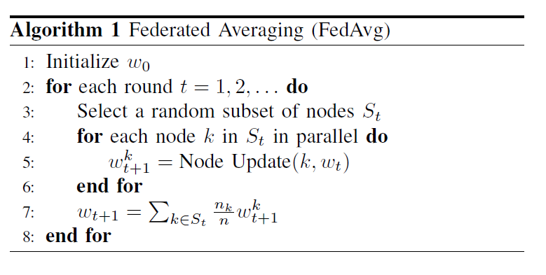
Figure 1: Federated Averaging Algorithm

Slide 8
Example
FL-Distributed Intrusion Detection System (FL-DIDS)
Main features:
Federated learning
Lightweight local models (ANN)
Asynchronous federated learning
Encrypted communication
Federated meta-learning

Slide 9
Example (continued)
How is FedAvg used in detecting attacks?
Each edge node trains its local ANN model.
Each node updates its model weight.
The server receives all model weights and computes a weighted average.
The server sends the new global model back to the nodes.
Each node has knowledge learned from the entire network.

Slide 10
b) FedProx
The server initializes a global model.
The server sends the model to the selected devices.
Each device trains the model locally.
An additional regularization term is added to the local loss function to penalize large deviations from the current global model.
Each device sends updated model parameters to the server.
The server computes the average of all received model parameters.
The averaged model becomes the new global model.
The process is repeated.

Slide 11
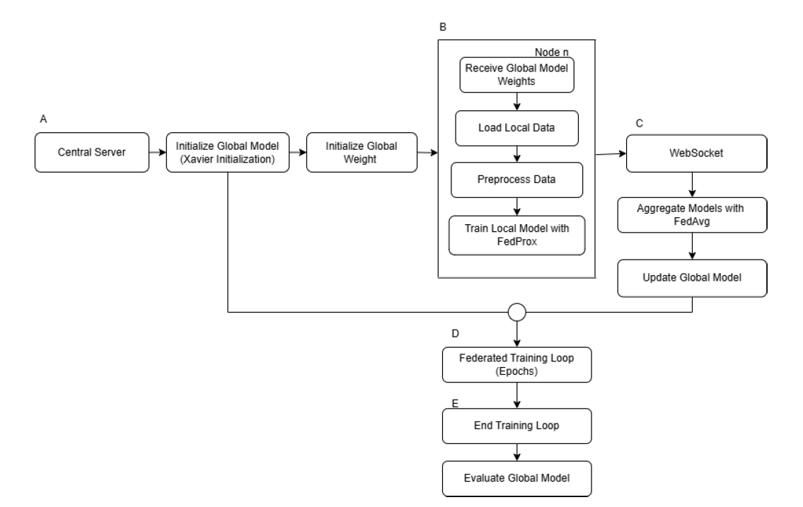
Figure 2: Federated Averaging for Intrusion Detection

Slide 12
Research gaps
Existing FedProx-based federated intrusion detection systems focus on optimizing the learning algorithm; however, automated feature selection is not yet explored.
Limited research has explored the resilience of FedProx-based IDS against federated learning attacks such as model poisoning, gradient inversion, and backdoor attacks.

Slide 13
c) FedSGD
Each node initializes its local model parameters randomly.
Each client computes the gradient of the local loss function.
Each node updates local model parameters.
Each client sends updated encrypted gradients back to the server.
The server calculates the average of the received gradients.
The server updates the global model and sends it back to the clients.
The process is repeated.

Slide 14
Example
This methodology is important in network security with distributed sensitive data across multiple nodes.
It aims to improve the model’s predictions without centralizing the raw data.

Slide 15
d) FedNova
Problem: different clients have different computational power and train for different numbers of local epochs.
Solution: FedNova normalizes each client’s update based on how much local training it performed.
Clients that train longer can have a large influence on the global model.
Note: an epoch is a complete pass through the entire training dataset.

Slide 16
e) SCAFOLD
Problem: Client drift caused by different data distribution.
Solution: SCAFOLD uses control variates on the client and server side to correct the direction of the local training.
=> Instead of letting clients drift in far directions, the control variates keep them closer to the global optimization path.

Slide 17
f) MOON
Problem: Local model drifting away from the global model.
Solution:
MOON adds a contrastive loss during local training to:
- Encourage the model to stay similar to the current global model
- Discourage the model from becoming very similar to the previous local model.

Slide 18
e) Zeno
Problem: malicious client updates.
Solution:
The server assigns a score to each client’s updates based on how much it helps reduce the global model loss.
=> Updates that improve the model are kept while the others are ignored.

Slide 19
references
Dhabliya, R., Senthil Ganesh, R., Rizvi, N., Agarwal, K., Deshmukh, G.B., Dongare, S.P. (2025). Towards Trustworthy Networks: A Collaborative Federated Learning Paradigm for Security Enhancement. In: Bhateja, V., Patel, P., Simic, M. (eds) Intelligent Data Engineering and Analytics. FICTA 2024 2024. Smart Innovation, Systems and Technologies, vol 420. Springer, Singapore. https://doi.org/10.1007/978-981-96-0139-4_37
P. Gupta, B. Sengupta and S. Nandi, "Federated Learning-Driven Intrusion Detection for Cybersecurity in Smart Distribution system," 2024 IEEE Globecom Workshops (GC Wkshps), Cape Town, South Africa, 2024, pp. 1-6, doi: 10.1109/GCWkshp64532.2024.11101136.
F. A. Ahmed, A. Mahmood, M. Sultana and S. Akhter, "FedProx-IDS: A Stable and Scalable Federated Learning Framework for Intrusion Detection," 2025 28th International Conference on Computer and Information Technology (ICCIT), Cox's Bazar, Bangladesh, 2025, pp. 682-687, doi: 10.1109/ICCIT68739.2025.11491541.
A. B. Said, J. Yao and N. Shahriar, "Federated Learning for DDoS Attack Detection: Enhancing Security with Misclassification Penalties," 2026 International Conference on Computing, Networking and Communications (ICNC), Maui, HI, USA, 2026, pp. 154-158, doi: 10.1109/ICNC68183.2026.11416833.
CS-E4740 Federated Learning ('25). (n.d.). YouTube. https://www.youtube.com/playlist?list=PLrbn2dGrLJK9rB05BObJGIcZP-g2nR28Y

Slide 20
Thank you!

